Slide 1
Automatic Language-Based Verification of
Differential Privacy
by
Chiké Abuah

Slide 2
Data Privacy
Goal: reveal trends in the population, without revealing information about individuals

Slide 3


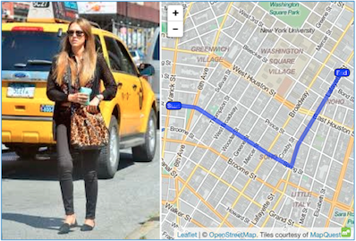
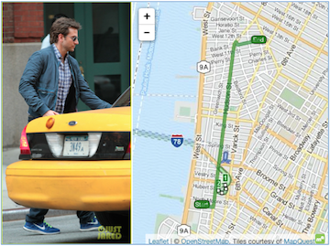
Why Do We Need Differential Privacy?
Ad-hoc privacy techniques (e.g. anonymization) can’t guarantee privacy
Subject to re-identification attacks
Netflix recommender algorithm prize (Narayanan et al.)
NYC taxi data (Anthony Tockar)
+

Slide 4


Differential Privacy is a Definition of Privacy
Adversary can’t tell from analysis result whether or not Chiké participated
Guarantee parameterized by ε (the privacy budget)
Query Result #1
Query
Database #1
+
≈
Chiké’s Data
Analyst
=
Query
Query Result #2
Database #2
Notes:
6min

Slide 5
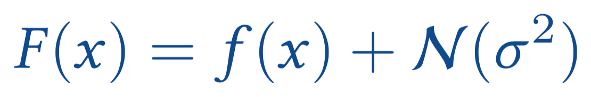
Satisfying Differential Privacy
To satisfy differential privacy, add noise to the query result
Noise
How much noise? It depends on f
How many trips were taken in New York last year?
If Chiké lives in Vermont, return 100000; else return 0
Low sensitivity
High sensitivity

Slide 6
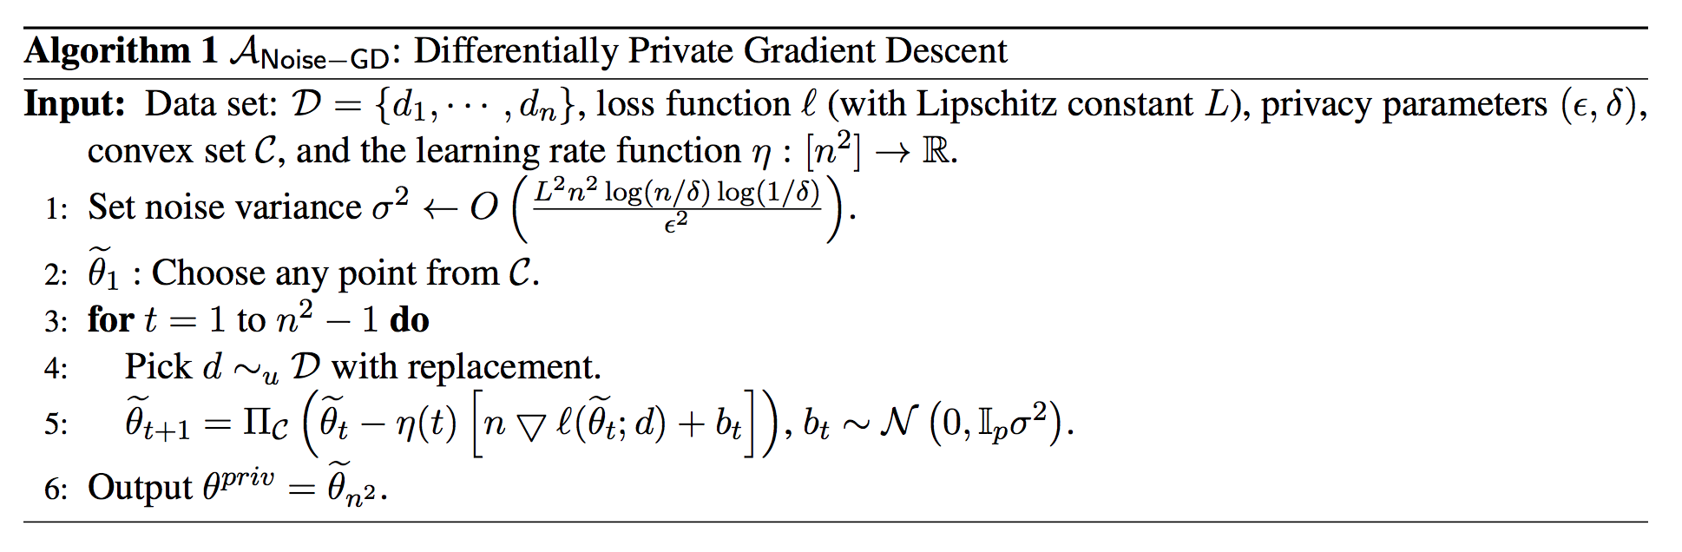
Why do we need Verification?
How do we know it’s the right amount of noise? Manual proof
Incorrect differentially private algorithms don’t crash
They silently violate your privacy

Slide 7
Privacy by (programming language) Design!
Accurate
Accessible to non-experts
Automatic
Ubiquitous
Context Matters: Support all manner of programs, systems, software, languages, modes of operation, etc.

Slide 8
Program Analysis Techniques
Static Analysis
Control Flow Analysis
Data Flow Analysis
Abstract Interpretation
Type Systems
Effect Systems
Model Checking
Dynamic Analysis
Testing
Monitoring (Runtime Verification)
Program Slicing

Slide 9
Talk Summary: Projects
Duet: PL, linear types for (ε,δ)
DDuo: dynamic analysis system
Solo: static analysis system

Slide 10
Big Picture Practical Significance
In practice differential privacy can be difficult to analyze. This work proposes several techniques for automatic analysis and convenient implementation of differential privacy.
Ideally, little or no domain knowledge should be required from programmers.
Privacy violations are silent, making it an especially important field in which to apply verification techniques.

Slide 11
Threat Model
Assumes an “honest but fallible” programmer.
Does not address side-channels.
Terminated programs can be rerun safely (while consuming the privacy budget).

Slide 12
DUET: An Expressive Language for Statically Verifying Differential Privacy
(Published at OOPSLA 2019)
***ACM SIGPLAN Distinguished Paper Award Winner***

Slide 13
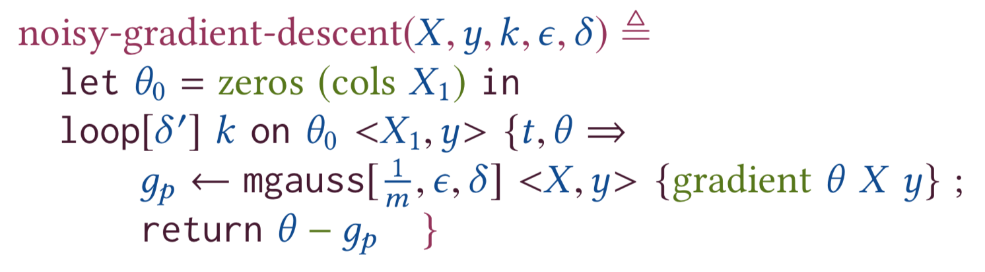
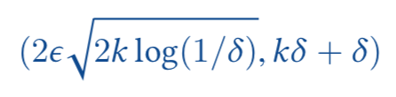
Duet is the first linear typed language to support verification of advanced variants of Differential Privacy
Duet automatically proves that:
satisfies
differential privacy

Slide 14
Duet’s Contributions
Support for (ε,δ)-DP and other variants in a linear type system
Expressive matrix types and API for machine learning
Ability to mix privacy variants within a single program
Advanced privacy variants are more accurate in most machine learning scenarios

Slide 15

Duet gets its name...
Duet is a co-design of two distinct, mutually embedded type systems:
one for sensitivity which leverages linear typing with scaling a la Fuzz, and
one for privacy which leverages linear typing without scaling and is novel in this work
However, to the user, it’s all just one language!

Slide 16
Duet’s Two Languages
Sensitivity Language
Gradient says how to improve model
Sensitivity: 1/m
Add noise to gradient to achieve (ε, δ)-DP
Interface between languages:
Gaussian mechanism
Privacy Language
Compose many iterations with advanced composition

Slide 17
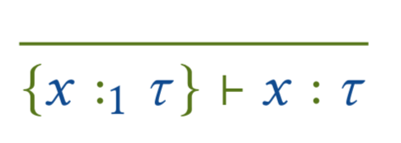
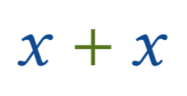
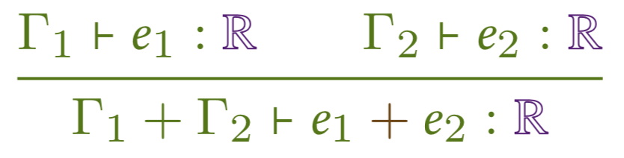
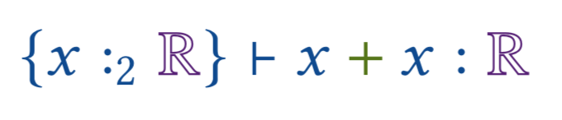
Linear Types for Sensitivity
2-sensitive in x
Context encodes sensitivity of x
Add up sensitivities for each variable
Fuzz: Jason Reed and Benjamin C Pierce. 2010. Distance makes the types grow stronger: a calculus for differential privacy. ICFP 45, 9 (2010).

Slide 18
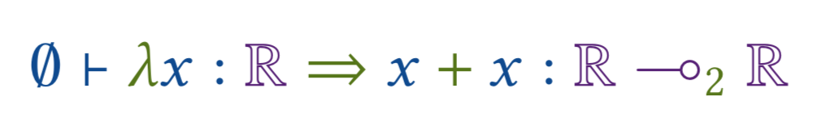
Sensitivity in Functions
2-sensitive function in x
Type of a 2-sensitive function

Slide 19
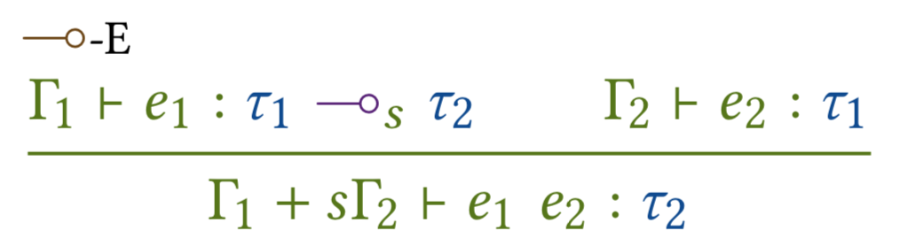
Scaling Sensitivity
2-sensitive function in x
Program is 4-sensitive in y
2-sensitive expression in y
Application rule scales context of the argument by the function’s sensitivity

Slide 20
Linear Types for Privacy
Context encodes privacy cost for x and y
Body expression
Privacy parameters
“Important” variables

Slide 21
Privacy Scaling is Not Allowed
✗
Scaling is allowed in ε-differential privacy (“group privacy”)
Used in Fuzz (Reed & Pierce 2010) and DFuzz (Gaboardi et al. 2013)
Scaling is not allowed in (ε,δ)-differential privacy

Slide 22
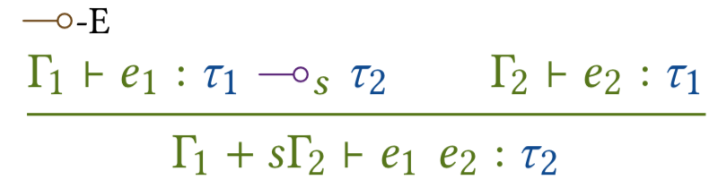
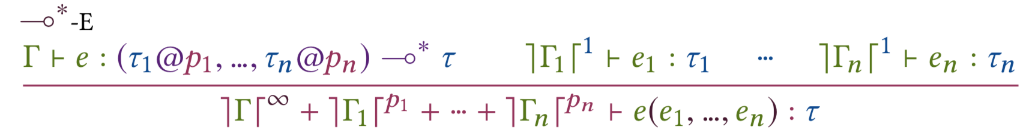
Duet’s Two Languages
Sensitivity language: scaling allowed
Privacy language: no scaling allowed

Slide 23
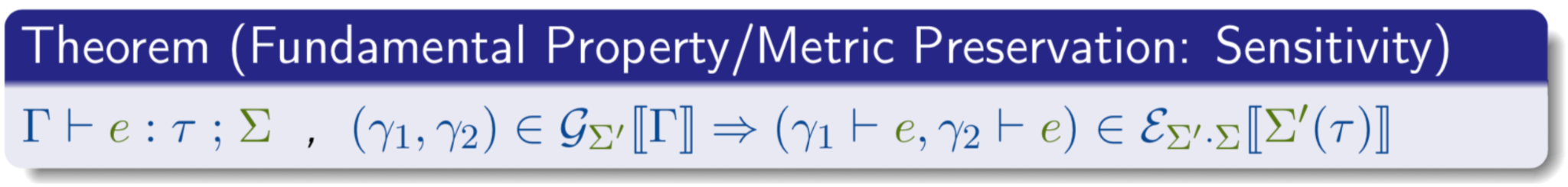
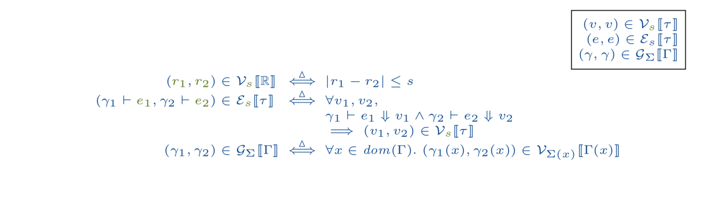
when given related initial configurations and evaluation outputs, then those outputs are related

Slide 24
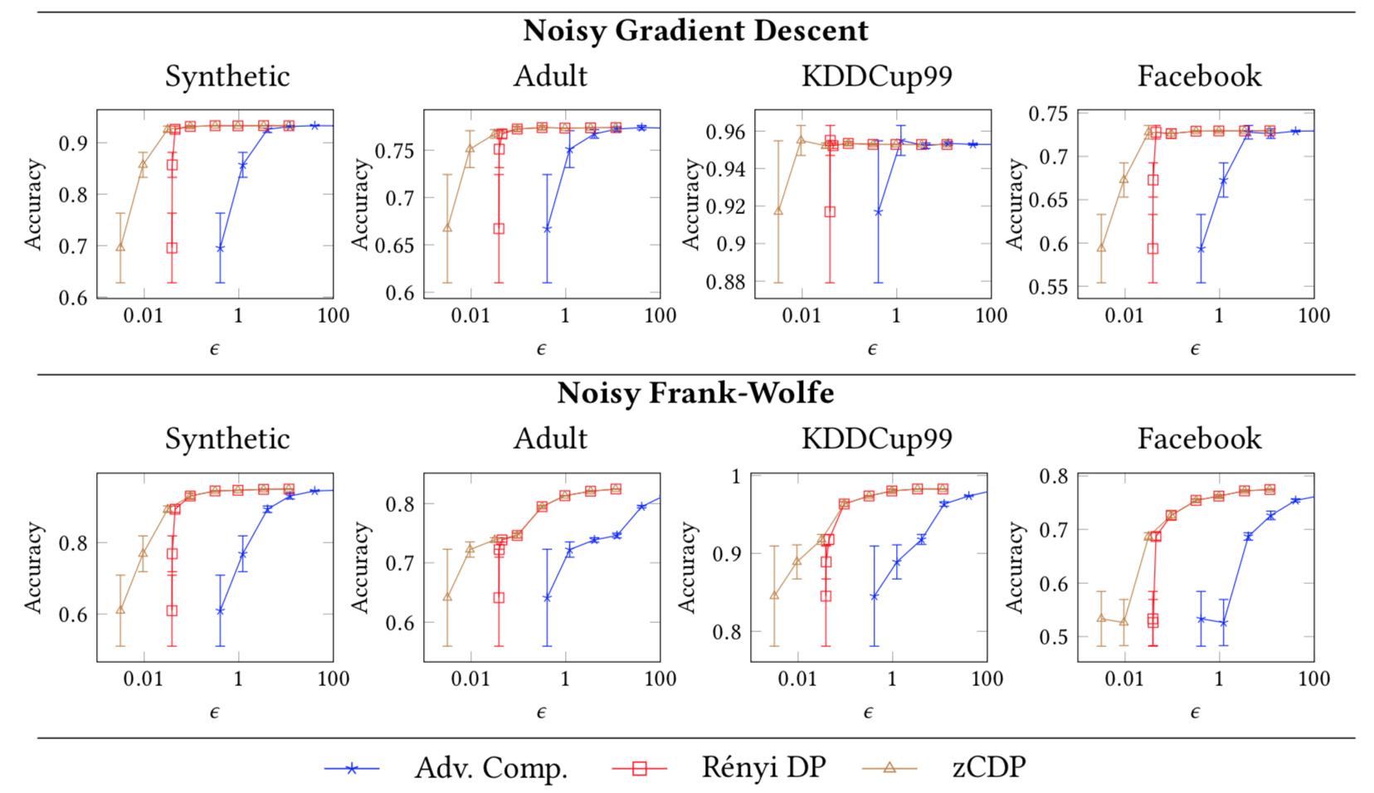
Empirical Results (Accuracy of Trained Models)
Duet programs produce state-of-the-art accuracy in private linear models

Slide 25
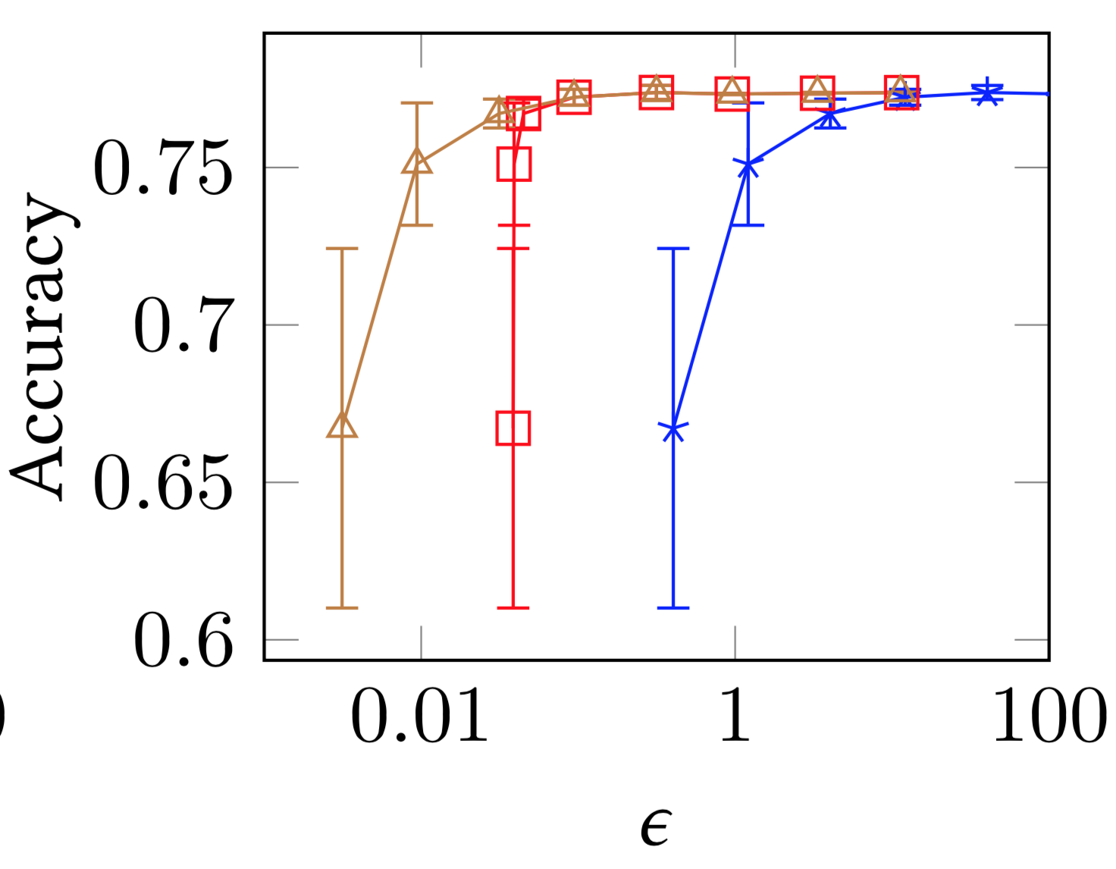
Benefit of Differential Privacy Variants
Recent privacy variants yield better accuracy at the same level of privacy

Slide 26
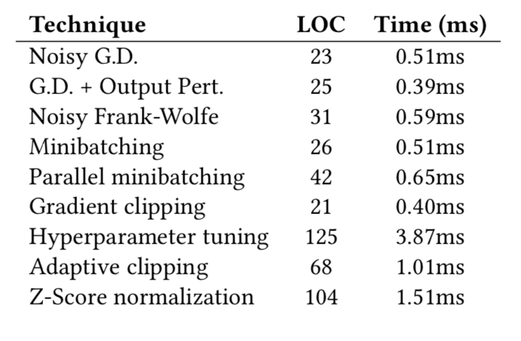
Empirical Results (Typechecker Performance)
Typechecker computes privacy cost of complex programs in milliseconds

Slide 27
DDUO: General-Purpose Dynamic Analysis for Differential Privacy
(Published at CSF 2021)

Slide 28
Contributions!
includes all base types
general language operations
various notions of sensitivity
advanced privacy variants
generalizes to all future possible arbitrary inputs

Slide 29
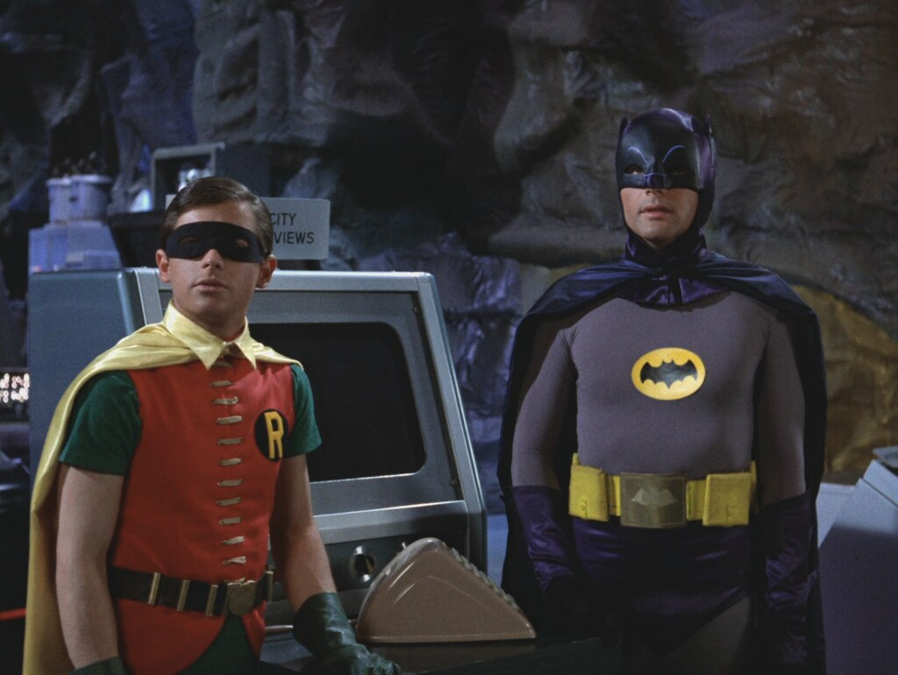
DDUO gets its name from...

Slide 30
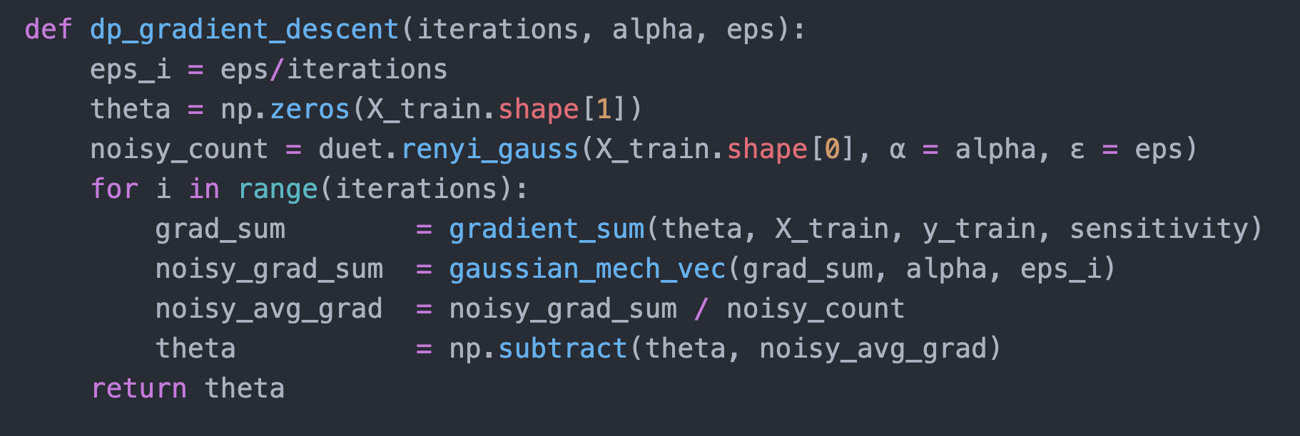
Product: DDUO makes it easy to automatically enforce privacy
Usable
For non-experts
Capable of complex algorithms

Slide 31
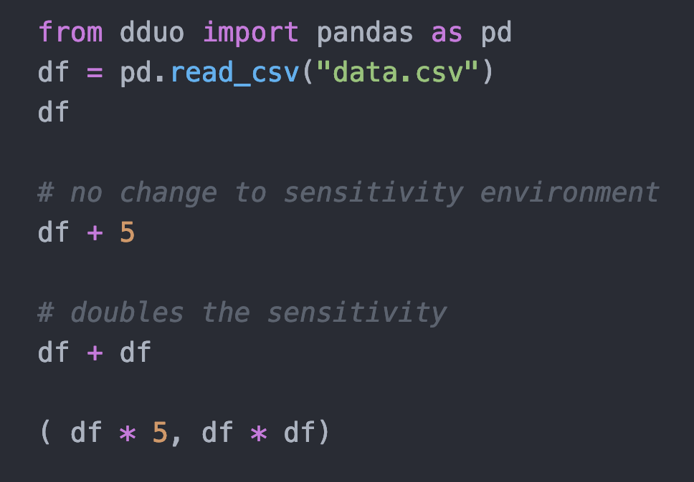
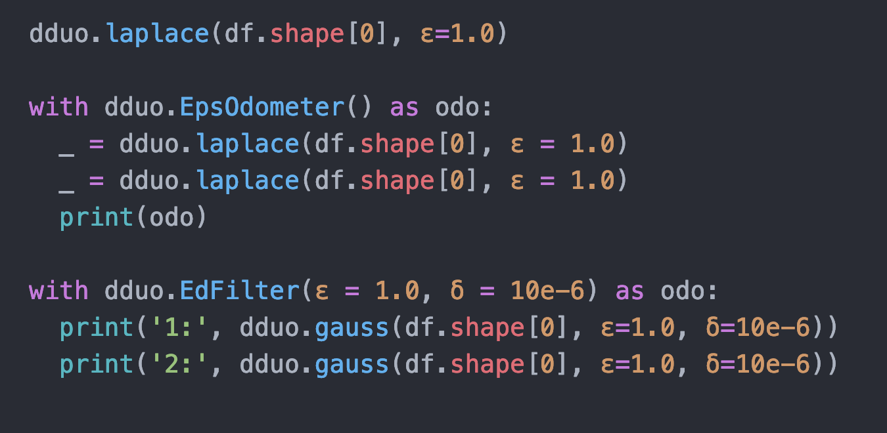
DDUO is prototyped in Python
Does not require the programmer to write any additional type annotations.
In many cases, DDUO can verify differential privacy for essentially unmodified Python programs.
easily integrated with popular libraries like Pandas and NumPy.

Slide 32
DDUO Overview
DDUO data sources are wrappers around sensitive data.
DDUO tracks the sensitivity of a value to changes in the program’s inputs using a sensitivity environment mapping input data sources to sensitivities.
Sensitivity environments of Sensitive objects update as operations are applied to them (f (x ) = x + x).
DDUO tracks total privacy cost using objects called privacy odometers.
DDUO also allows the analyst to place upper bounds on total privacy cost (i.e. a privacy budget) using privacy filters.

Slide 33
Sensitivity Analysis: Object Proxies
>>> Sensitive(<'DataFrame'>, data.csv ↦ 1, L∞)
>>> Sensitive(<'DataFrame'>, data.csv ↦ 1, L∞)
>>> Sensitive(<'DataFrame'>, data.csv ↦ 2, L∞)
>>> (Sensitive(<'DataFrame'>, data.csv ↦ 5, L∞),Sensitive(<'DataFrame'>, data.csv ↦ ∞, L∞))

Slide 34
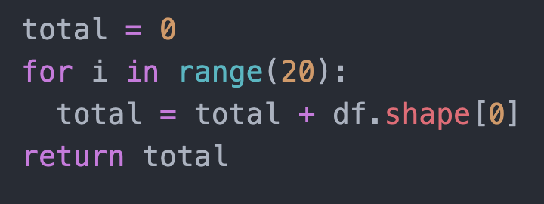
Side-effects/Mutation
Since DDUO attaches sensitivity environments to values (instead of variables), the use of side effects does not affect the soundness of the analysis
When a program variable is updated to reference a new value, that value’s sensitivity environment remains attached.
more capable than traditional type-based static analysis, due to the additional challenges there (e.g. aliasing).
>>> Sensitive(<'DataFrame'>, data.csv ↦ 20, L∞)

Slide 35
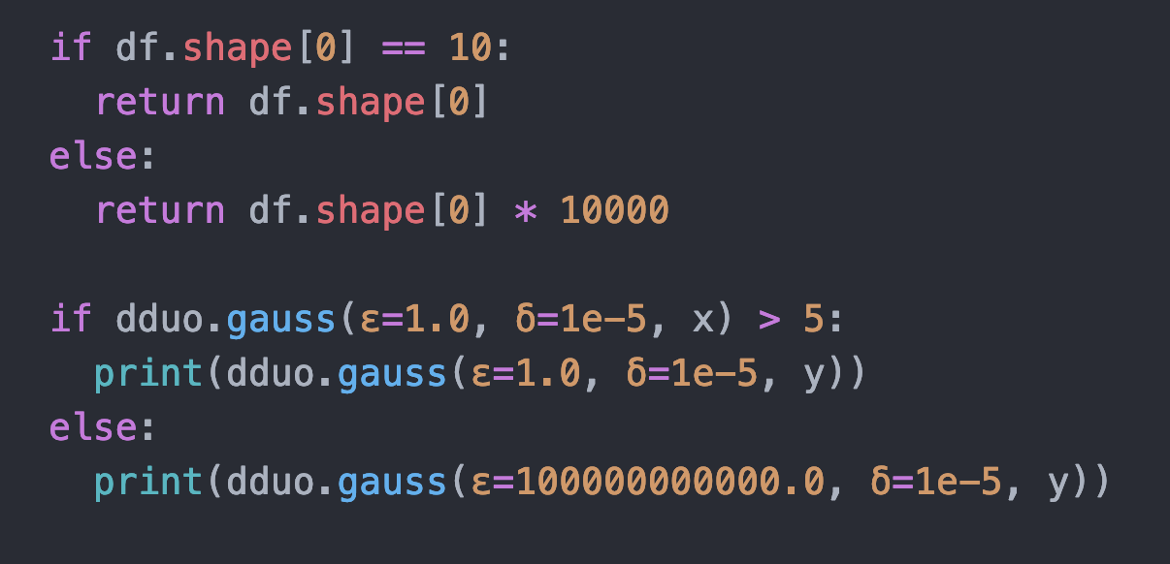
Conditionals
- Branching on sensitive values is disallowed
- We don’t want this anyway
- Static Analysis: Take the max!
- Dynamic Analysis: …?
- Adaptive privacy analysis requires use of privacy odometers/filters

Slide 36
Privacy Analysis: Filters and Odometers
>>> 9.963971319623278
>>> Odometer_ε(data.csv ↦ 2.0)
>>> 1: 10.5627
Traceback (most recent call last):
...
dduo.PrivacyFilterException

Slide 37
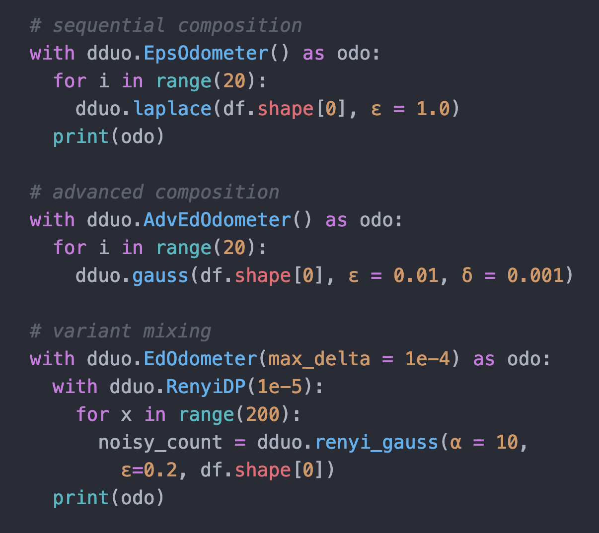
Loops, Composition, Variants
- sequential composition
- advanced composition
- variant mixing

Slide 38
Gradient Descent in DDUO
Bound sensitivity of gradient calculation.
Add random noise.
Descend model with noisy gradient.

Slide 39
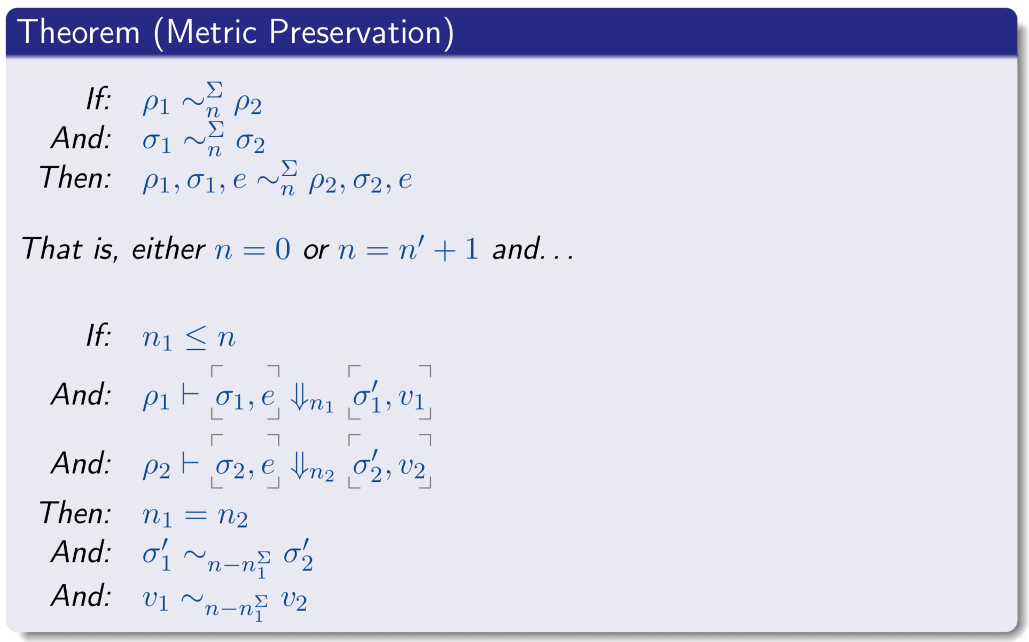
the true sensitivity of a program is guaranteed to be equal to or less than the sensitivity reported by DDUO’s dynamic monitor.
accurate — even for inputs which differ entirely from those used in the dynamic analysis!

Slide 40
Case Studies: Dynamic Enforcement of Privacy
Algorithm | Libraries Used | Baseline | Instrumented Version | Overhead (% increase)
Noisy Gradient Descent | NumPy | 5.922s | 6.302s | 6.42%
Multiplicative Weights (MWEM) | Pandas | 0.725s | 0.833s | 14.90%
Private Naive Bayes Classification | DiffPrivLib | 2.155s | 2.423s | 12.44%
Private Logistic Regression | DiffPrivLib | 2.022s | 3.161s | 56.33%

Slide 41
Solo: Lightweight Static Analysis for Differential Privacy
(Published at OOPSLA 2022)

Slide 42
Why Solo?
Linear types provide a strategy rooted in type theory and linear logic for tracking resources throughout the semantics of a core lambda calculus.
However, not commonly available in mainstream programming languages, and when available are usually not adequately sophisticated.

Slide 43
What is Solo?
Static type checking for differential privacy in Haskell
Doesn’t use linear types!
Static analysis via (in tandem with) Haskell typechecker
Regular Haskell type errors when privacy is violated
Privacy cost along with types of functions & values
Encapsulation of sensitive values via constructor hiding
Automatic type inference

Slide 44
How does it work?
Without linear types, where do we attach sensitivities?
Previous dynamic sensitivity analyses have attached sensitivities to values.
We embed sensitivities in base types—the static equivalent of the dynamic strategy of attaching sensitivities to values.
Type-level parameters to represent sensitivities symbolically.
Type-level computation to compute symbolic sensitivity expressions.
Parametric polymorphism to generalize types over sensitivity parameters.
Possible in any language with these e.g. Scala, OCaml and Haskell.

Slide 45
Departure from Linear types
case statements are restricted to have the same sensitivity (or privacy cost) in each case alternative, rather than max. Solved by weaken operation.
No verified/typechecked map or loop. However trusted primitives are available.
No general recursive datatypes. However, sensitive collection data types are available.
In practice, none of these are typically barriers to writing differentially private programs.

Slide 46

Solo gets its name from …

Slide 47
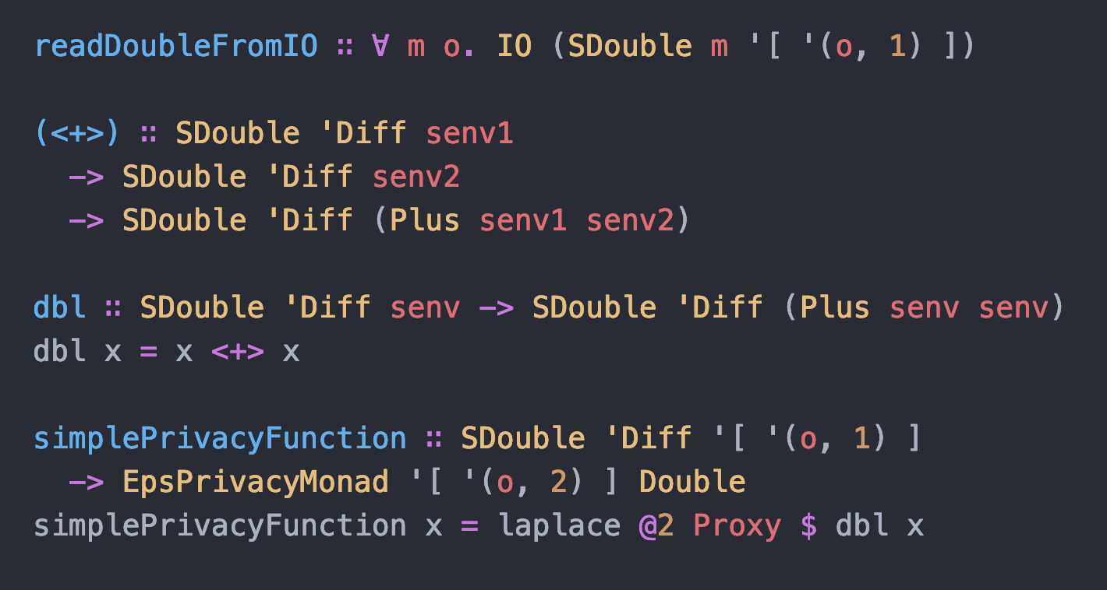
Basics: Tracking Sensitivity & Privacy
Data source based approach
Type-level sensitivity parameters on “sensitive” types
Parametric effect monad: unifies privacy effect system with a monadic-style semantics

Slide 48
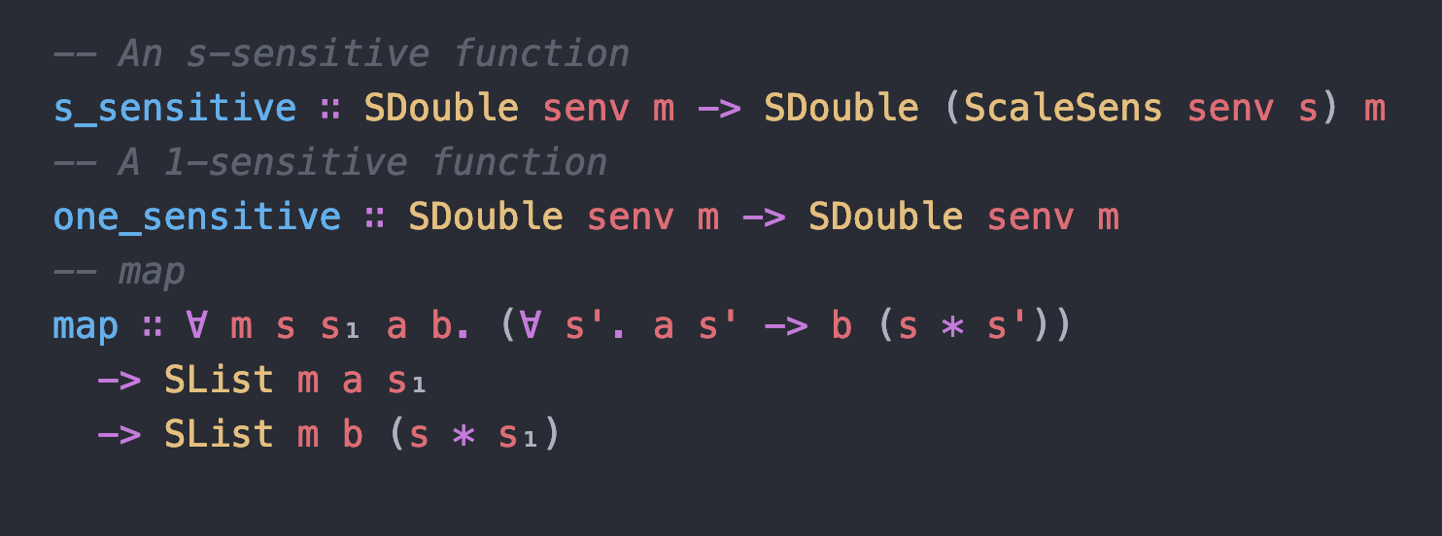
Functions
Function types are polymorphic over sensitivity environments

Slide 49
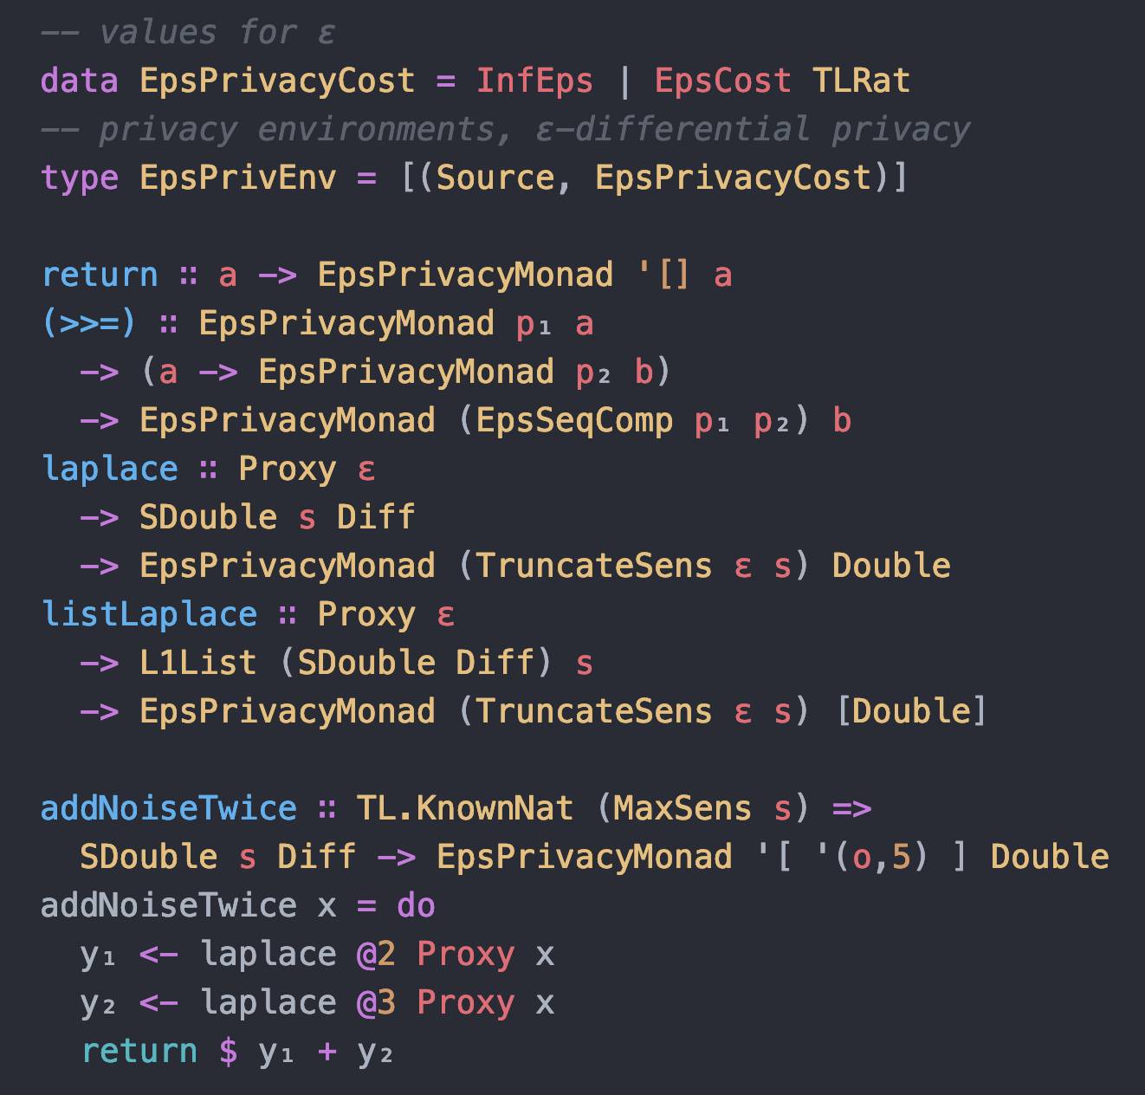
Privacy Monad
The return operation accepts some value and embeds it in the PrivacyMonad without causing any side-effects.
The (>>=) ( bind ) operation allows us to sequence private computations using differential privacy’s sequential composition property

Slide 50
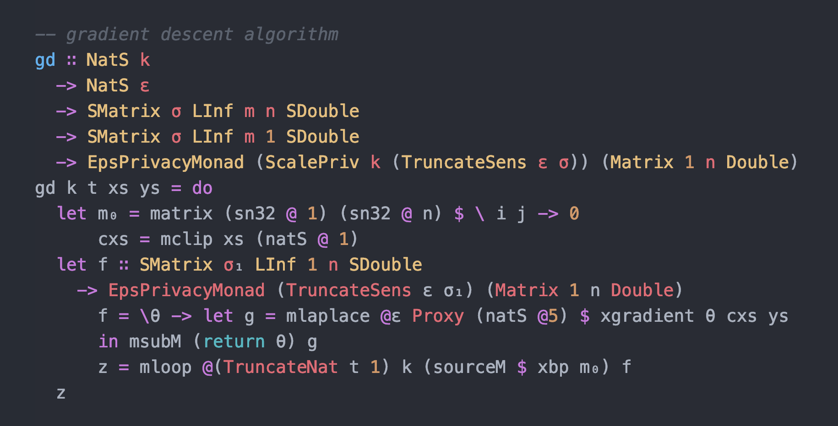
Case study: gradient descent

Slide 51
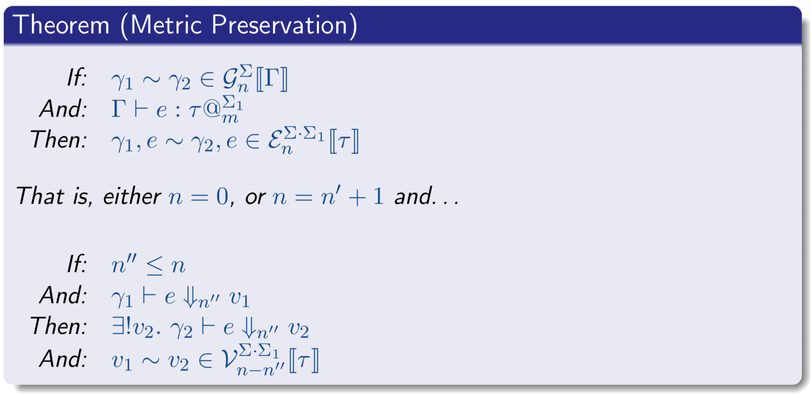
Proof: similar to DDuo but with type info

Slide 52
Solo: Case Studies
Solo reference implementation is a (~600 loc) Haskell library
K-means clustering
Cumulative Distribution Function
Gradient Descent
Multiplicative-Weights Exponential Mechanism (MWEM)

Slide 53
Related Work

Slide 54
Related Work: Statically Typed
Linear Type Systems
Fuzz, DFuzz (only ε-differential privacy)
Indexed Monadic Types
HOARe² (lacks multi-argument support)
Relational Type Systems
LightDP (lacks sensitivity analysis)
Type Systems Enriched With Program Logics
Fuzzi (less support for higher-order/type-checking automation)

Slide 55
Related Work: Dynamically Typed
PINQ (lacks support for general-purpose programming)
ProPer (per-user budget)
UniTrax (per-user w/abstract db)
Testing Methods (counter-example search)

Slide 56
Related Work: Other Privacy Analysis Software Libraries
DiffPrivLib (no language-based sensitivity/composition)
Google’s Privacy Lib (no language-based sensitivity/composition)
Ektelo (plans over library of operators, no general PL model)
DPella (AST analysis, symbolic interpretation)

Slide 57
Future Work & Conclusions

Slide 58
Open Problem/Future Work
Property-based testing, sensitivity analysis for large software libraries
Gradual Differential Privacy

Slide 59
Takeaways!
Analysis for differential privacy is important: buggy programs silently violate your privacy
Automated enforcement of privacy can be practical in any context!

Slide 60
https://github.com/uvm-plaid/duet
https://github.com/uvm-plaid/dduo-python
https://github.com/uvm-plaid/solo-haskell
Papers: https://chikeabuah.github.io/

Slide 61
Thank You!
Questions?

